Slide 1
Mesh generation and coding in FEniCS
Yuxiang Gao

Slide 2

FEniCS
An open-source computing platform for solving partial differential equations (PDEs).
Python and C++ interface.
Can run on a multitude of platforms but mainly for Linux.
FEniCSx is the latest project but there are less tutorial and code resources than FEniCS.

Slide 3
FEniCS installation
Official Download tutorial https://fenicsproject.org/download/archive/
Run FEniCS code in Docker so it works for all OS (Windows, Mac and Linux).
Docker can provide a virtual OS and enable you to download and run the prebuilt FEniCS image (based on Linux).

Slide 4

Install Docker
Install Docker for desktop and laptop https://www.docker.com/products/docker-desktop/

Slide 5
Start FEniCS environment
Start Docker
Change the path to the working directory (folder) in the terminal window
Enter the following command in the terminal window to start FEniCS

Slide 6
Start FEniCS environment
Windows:
docker run -ti -p 127.0.0.1:8000:8000 -v %cd%:/home/fenics/shared -w /home/fenics/shared quay.io/fenicsproject/stable:2016.2.0
MacOS:
docker run -ti -p 127.0.0.1:8000:8000 -v $(pwd):/home/fenics/shared -w /home/fenics/shared quay.io/fenicsproject/stable:2016.2.0
Reference:
127.0.0.1:8000:8000 : The port of the container (your FEniCS environment). Need to be different for different containers.
%cd% or $(pwd) : Current path. Only need to note that it’s different for Windows and MacOS/Linux.
2016.2.0 : The version of the FEniCS. Can be replaced with current.
More reference of docker command: https://docs.docker.com/engine/reference/run/

Slide 7
Run FEniCS python code
The python based FEniCS program can be run by
python filename.py

Slide 8
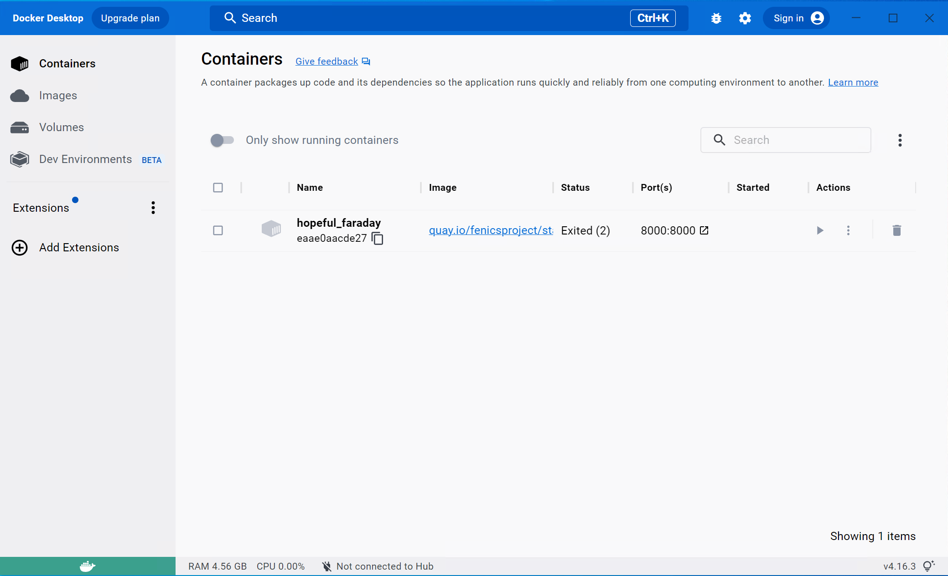
Delete the container
By GUI (Windows example):
By command (In a new terminal):
First, stop all containers by
docker stop $(docker ps -q);
Then, remove all stopped containers by
docker rm $(docker ps --filter status=exited -q)

Slide 9
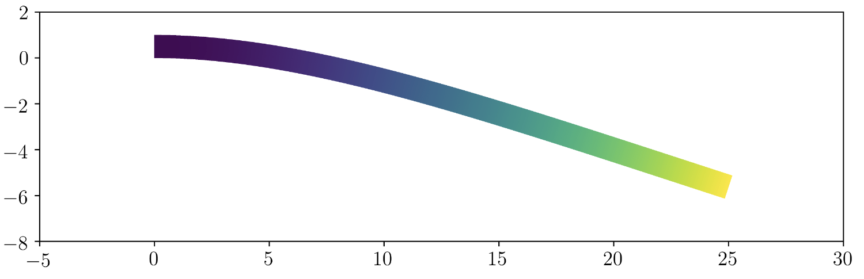
2D elasticity problem
An example from
Bleyer, J. (n.d.). Numerical tours of continuum mechanics using FEniCS. 125.
https://comet-fenics.readthedocs.io/en/latest/demo/elasticity/2D_elasticity.py.html
Cantilever beam under gravity (body force).

Slide 10
Mesh generation by Gmsh
Free: Open-source 3D finite element mesh generator
Parametric modeling: The Gmsh application programming interface (API) allows to integrate the Gmsh library in external applications written in C++, C, Python, Julia or Fortran.
Document: https://gmsh.info/doc/texinfo/gmsh.html
For using Python script, you can install Gmsh by
pip install --upgrade gmsh

Slide 11
Mesh generation by Gmsh Python script
Draw geometry by Gmsh inbuild CAD functions
Pass the geometry to Gmsh meshing
Define the meshing parameters
Generate the mesh and save them

Slide 12
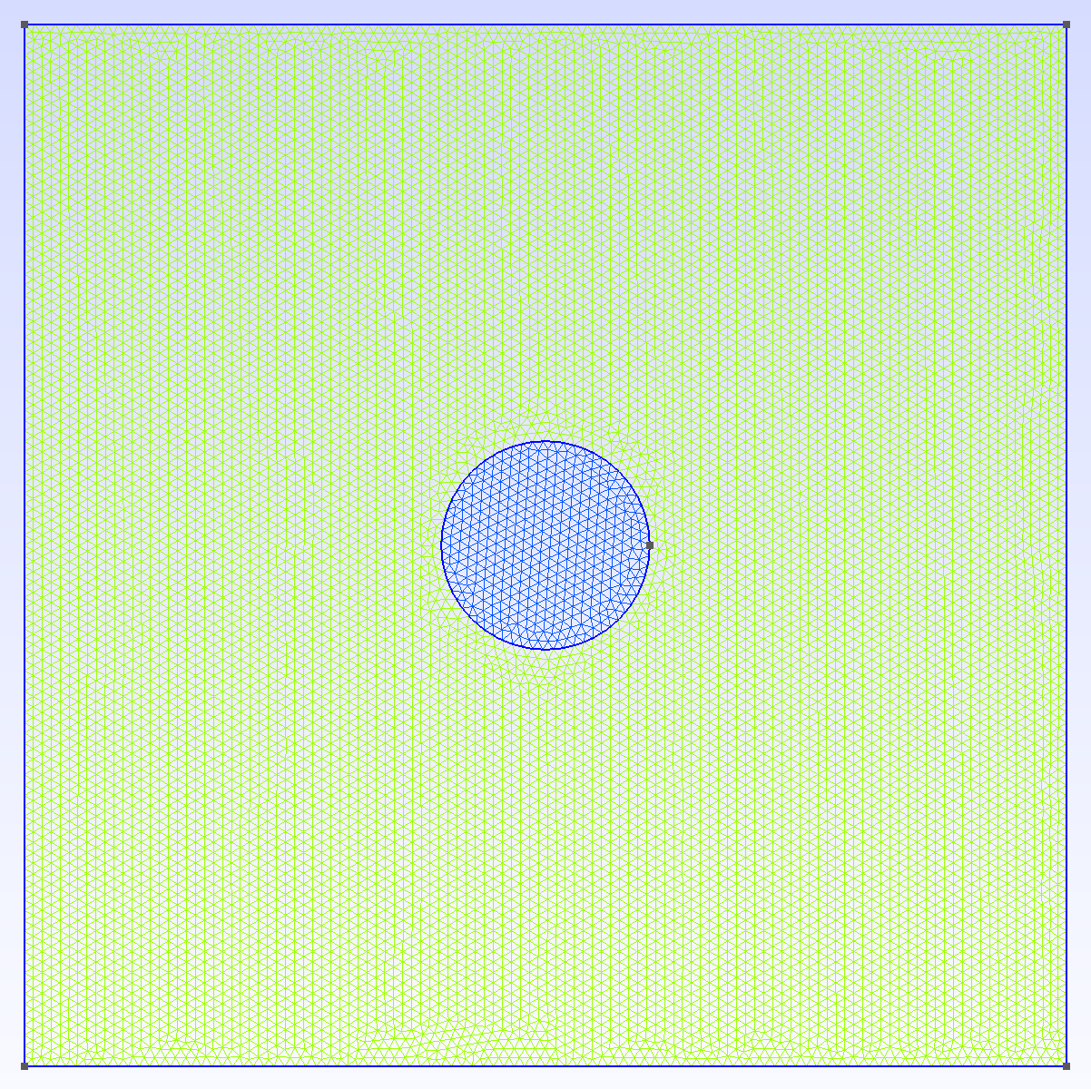
Mesh generation by Gmsh Python script
An example: Generate FEM mesh for a square plate with fiber by Python.

Slide 13
Import 2d triangle mesh from Gmsh
Generate mesh in Gmsh and save the mesh as .dat file
Convert the .dat file to .xml file with the format loadable by FEniCS by Gmsh2xml.py (posted on GitHub)
You need to state the name of the mesh file in the code.
In FEniCS code, import the xml mesh by
mesh = Mesh("mesh.xml")

Slide 14
Materials
Codes are on GitHub
https://github.com/YuxiangGao0321/FEniCS_tutorial_2023
Books for FEniCS
Bleyer, J. (n.d.). Numerical tours of continuum mechanics using FEniCS. 125.
Langtangen, H. P., & Logg, A. (n.d.). Solving PDEs in Python – The FEniCS Tutorial Volume I. 153.
Logg, A., Mardal, K.-A., & Wells, G. (Eds.). (2012). Automated Solution of Differential Equations by the Finite Element Method (Vol. 84). Springer Berlin Heidelberg.

